Slide 1


Lecture 15
Produced by Dr. Worldwide
Welcome to the 305
~
~

Slide 2


Goal Programming
All prior linear programming problems have had a single objective function
Companies may have multiple criteria in consideration for a decision
Sometimes the multiple objectives conflict
Company may want to maximize profit and minimize pollution
Goal programming is linear programming for multiple objectives or criteria

Slide 3


Ex: Beaver Creek Pottery
Trying to choose $x=number of bowls$ and $y=number of mugs$ to maximize the profit function
Recall the original linear program
Objective function reflects a single goal
Maximize $40x+50y$
Subject to: $x+2y≤40$ (Labor)
$4x+3y≤120$ (Clay)
$x,y≥0$

Slide 4
Ex: Beaver Creek Pottery
Suppose Beaver Creek wanted to achieve other goals while maximizing profit
In order of importance:
To avoid layoffs, they want to use at least 40 hours of labor per day
They want to achieve a satisfactory profit level of $1,600 per day
To avoid having clay dry out, they prefer to keep no more than 120 lb of clay on hand each day
To avoid overhead costs due to keeping the factory open past normal hours, they want to minimize the amount of overtime
We reformulate our linear programming model using goal programming
Transform linear programming model constraints into goals

Slide 5
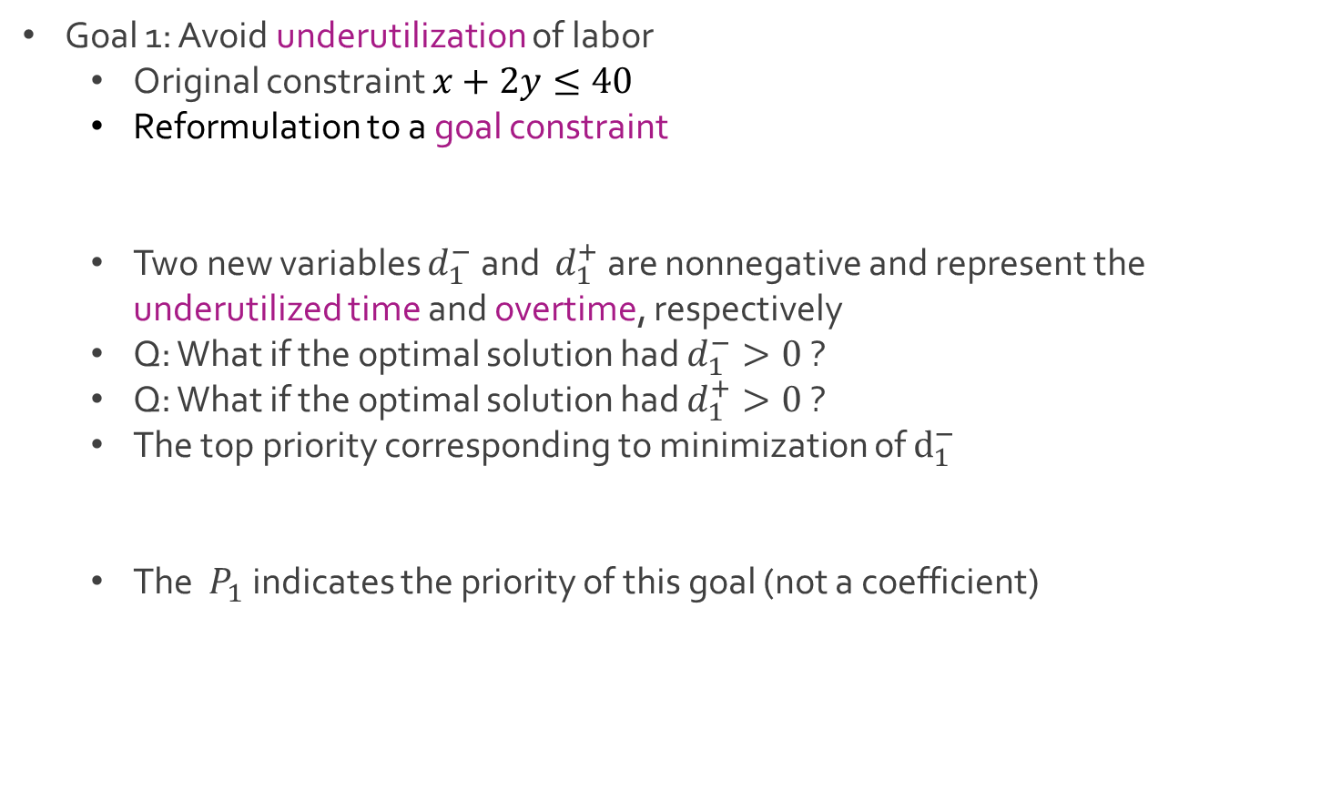
Ex: Beaver Creek Pottery
Goal 1: Avoid underutilization of labor
Original constraint $x+2y≤40$
Reformulation to a goal constraint
Two new variables $d_{1}^{−}$and $d_{1}^{+}$ are nonnegative and represent the underutilized time and overtime, respectively
Q: What if the optimal solution had $d_{1}^{−}>0$ ?
Q: What if the optimal solution had $d_{1}^{+}>0$ ?
The top priority corresponding to minimization of $d_{1}^{−}$
The $P_{1}$ indicates the priority of this goal (not a coefficient)
$x+2y+d_{1}^{−}−d_{1}^{+}=40$ (Labor)
Minimize $P_{1}d_{1}^{−}$

Slide 6
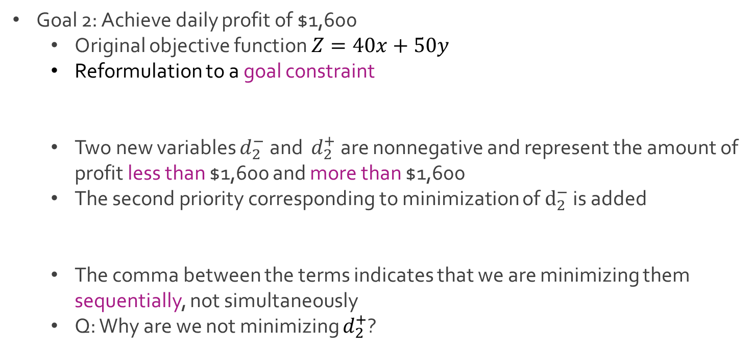
Ex: Beaver Creek Pottery
Goal 2: Achieve daily profit of $1,600
Original objective function $Z=40x+50y$
Reformulation to a goal constraint
Two new variables $d_{2}^{−}$and $d_{2}^{+}$ are nonnegative and represent the amount of profit less than $1,600 and more than $1,600
The second priority corresponding to minimization of $d_{2}^{−}$ is added
The comma between the terms indicates that we are minimizing them sequentially, not simultaneously
Q: Why are we not minimizing $d_{2}^{+}$?
$40x+50y+d_{2}^{−}−d_{2}^{+}=1600$ (Profit)
Minimize $P_{1}d_{1}^{−}, P_{2}d_{2}^{−}$

Slide 7
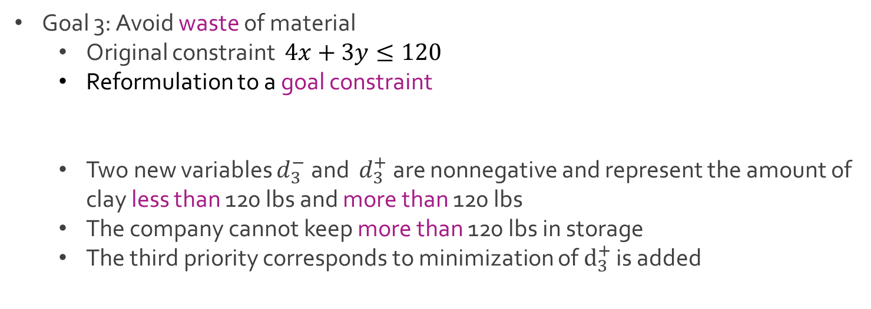
Ex: Beaver Creek Pottery
Goal 3: Avoid waste of material
Original constraint $4x+3y≤120$
Reformulation to a goal constraint
Two new variables $d_{3}^{−}$and $d_{3}^{+}$ are nonnegative and represent the amount of clay less than 120 lbs and more than 120 lbs
The company cannot keep more than 120 lbs in storage
The third priority corresponds to minimization of $d_{3}^{+}$ is added
$4x+3y+d_{3}^{−}−d_{3}^{+}=120$ (Clay)
Minimize $P_{1}d_{1}^{−}, P_{2}d_{2}^{−}, P_{3}d_{3}^{+}$

Slide 8
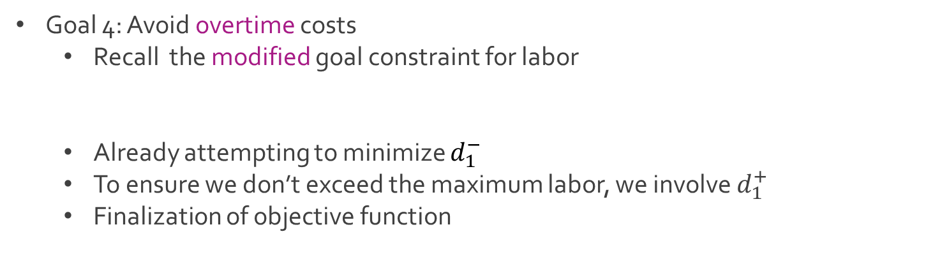
Ex: Beaver Creek Pottery
Goal 4: Avoid overtime costs
Recall the modified goal constraint for labor
Already attempting to minimize $d_{1}^{−}$
To ensure we don’t exceed the maximum labor, we involve $d_{1}^{+}$
Finalization of objective function
$x+2y+d_{1}^{−}−d_{1}^{+}=40$ (Labor)
Minimize $P_{1}d_{1}^{−}, P_{2}d_{2}^{−}, P_{3}d_{3}^{+},P_{4}d_{1}^{+}$

Slide 9
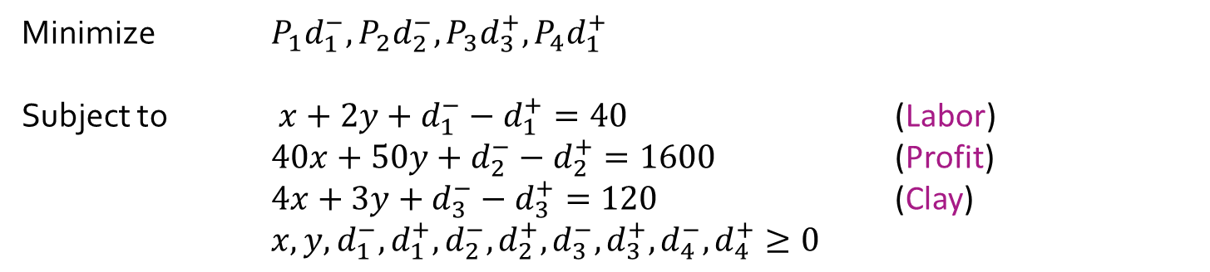

Ex: Beaver Creek Pottery
Full goal programming model
The variables $\left\{d_{1}^{−},d_{1}^{+},d_{2}^{−},d_{2}^{+},d_{3}^{−},d_{3}^{+},d_{4}^{−},d_{4}^{+}\right\}$ are called deviational variables
We minimize the four different objective functions individually by priority
Minimize $P_{1}d_{1}^{−}, P_{2}d_{2}^{−}, P_{3}d_{3}^{+},P_{4}d_{1}^{+}$
Subject to $x+2y+d_{1}^{−}−d_{1}^{+}=40$ (Labor)
$40x+50y+d_{2}^{−}−d_{2}^{+}=1600$ (Profit)
$4x+3y+d_{3}^{−}−d_{3}^{+}=120$ (Clay)
$x,y,d_{1}^{−},d_{1}^{+},d_{2}^{−},d_{2}^{+},d_{3}^{−},d_{3}^{+},d_{4}^{−},d_{4}^{+}≥0$

Slide 10
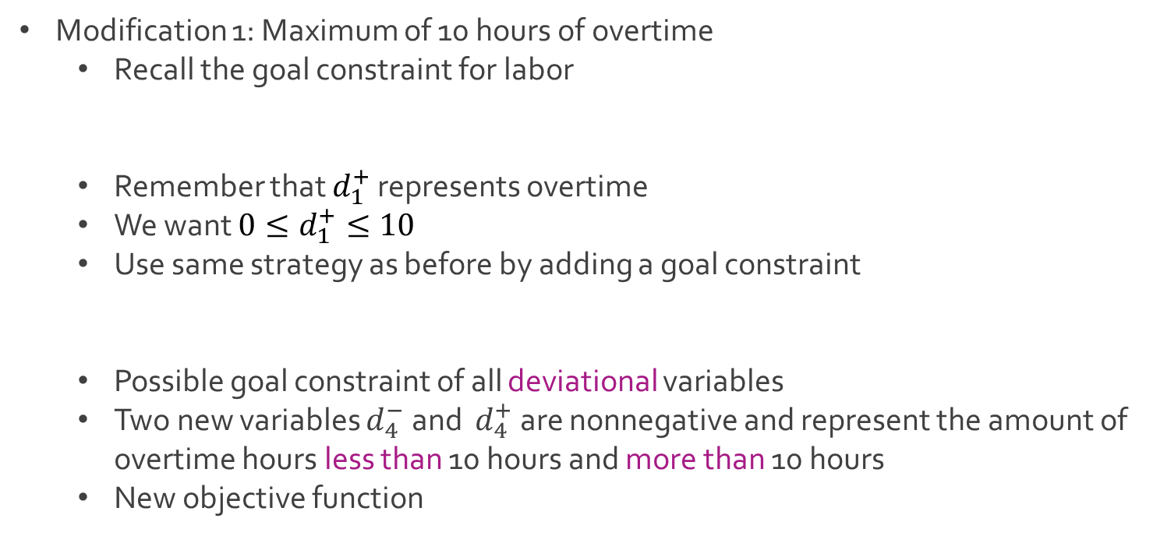
Ex: Beaver Creek Pottery
Modification 1: Maximum of 10 hours of overtime
Recall the goal constraint for labor
Remember that $d_{1}^{+}$ represents overtime
We want ${0≤d}_{1}^{+}≤10$
Use same strategy as before by adding a goal constraint
Possible goal constraint of all deviational variables
Two new variables $d_{4}^{−}$and $d_{4}^{+}$ are nonnegative and represent the amount of overtime hours less than 10 hours and more than 10 hours
New objective function
$x+2y+d_{1}^{−}−d_{1}^{+}=40$ (Under hours)
$d_{1}^{+}+d_{4}^{−}−d_{4}^{+}=10$ (Over hours)
Minimize $P_{1}d_{1}^{−}, P_{2}d_{2}^{−}, P_{3}d_{3}^{+},P_{4}d_{4}^{+}$

Slide 11
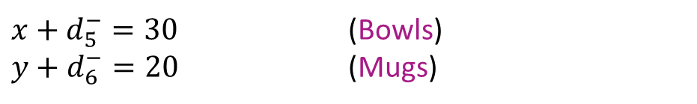
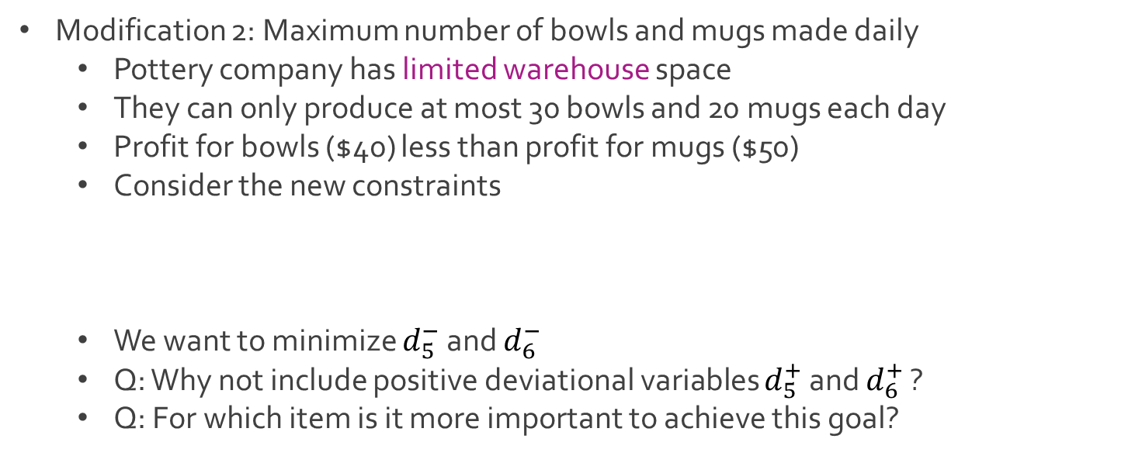
Ex: Beaver Creek Pottery
Modification 2: Maximum number of bowls and mugs made daily
Pottery company has limited warehouse space
They can only produce at most 30 bowls and 20 mugs each day
Profit for bowls ($40) less than profit for mugs ($50)
Consider the new constraints
We want to minimize $d_{5}^{−}$ and $d_{6}^{−}$
Q: Why not include positive deviational variables $d_{5}^{+}$ and $d_{6}^{+}$ ?
Q: For which item is it more important to achieve this goal?
$x+d_{5}^{−}=30$ (Bowls)
$y+d_{6}^{−}=20$ (Mugs)

Slide 12
Ex: Beaver Creek Pottery
Modification 2: Maximum number of bowls and mugs made daily
Positive deviational variables are unnecessary since it is imperative to not exceed the warehouse space
We need to achieve the goal for mugs more than the goal for bowls because the profit is higher for mugs
If goals were of equal importance, we would minimize
We can make the degree of importance in proportion to the profit
The goal for mugs is more important than the goal for bowls by a ratio of 5 to 4
The coefficients 4 and 5 are referred to as weights
Minimize $P_{1}d_{1}^{−}, P_{2}d_{2}^{−}, P_{3}d_{3}^{+},P_{4}d_{4}^{+},P_{5}d_{5}^{−}+$ $P_{5}d_{6}^{−}$
Minimize $P_{1}d_{1}^{−}, P_{2}d_{2}^{−}, P_{3}d_{3}^{+},P_{4}d_{4}^{+},{4P}_{5}d_{5}^{−}+$ ${5P}_{5}d_{6}^{−}$

Slide 13
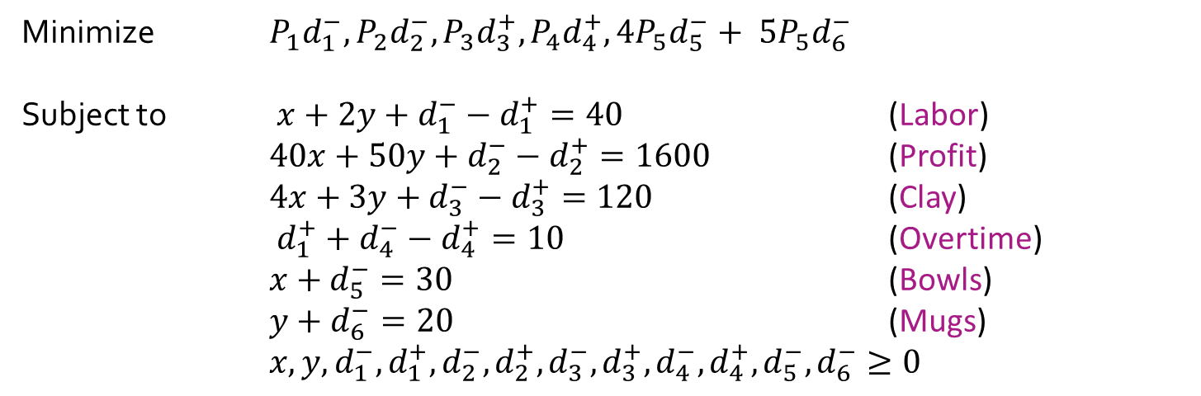
Ex: Beaver Creek Pottery
Full modified goal programming model
Minimize $P_{1}d_{1}^{−}, P_{2}d_{2}^{−}, P_{3}d_{3}^{+},P_{4}d_{4}^{+},{4P}_{5}d_{5}^{−}+ {5P}_{5}d_{6}^{−}$
Subject to $x+2y+d_{1}^{−}−d_{1}^{+}=40$ (Labor)
$40x+50y+d_{2}^{−}−d_{2}^{+}=1600$ (Profit)
$4x+3y+d_{3}^{−}−d_{3}^{+}=120$ (Clay)
$d_{1}^{+}+d_{4}^{−}−d_{4}^{+}=10$ (Overtime)
$x+d_{5}^{−}=30$ (Bowls)
$y+d_{6}^{−}=20$ (Mugs)
$x,y,d_{1}^{−},d_{1}^{+},d_{2}^{−},d_{2}^{+},d_{3}^{−},d_{3}^{+},d_{4}^{−},d_{4}^{+},d_{5}^{−},d_{6}^{−}≥0$

Slide 14
Excel for Goal Programming
Builds off linear programming using Excel Solver
Solve the linear program multiple times with different objective functions
Go in order of priority
After finding the optimal solution, we add the optimal value attained in the first objective function as a new constraint and move on to the next objective function
Possible that while solving for a given priority, we simultaneously optimize other lower ranked priorities

Slide 15
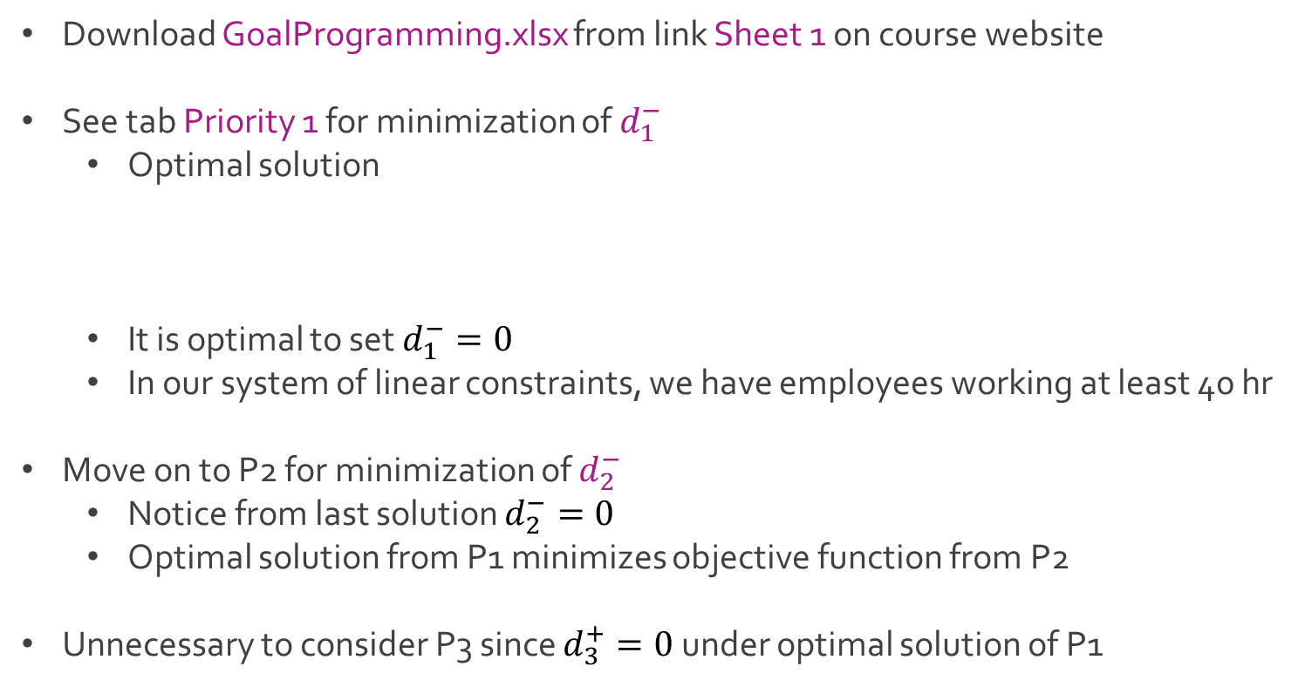
Ex: Beaver Creek Pottery
Download GoalProgramming.xlsx from link Sheet 1 on course website
See tab Priority 1 for minimization of $d_{1}^{−}$
Optimal solution
It is optimal to set $d_{1}^{−}=0$
In our system of linear constraints, we have employees working at least 40 hr
Move on to P2 for minimization of $d_{2}^{−}$
Notice from last solution $d_{2}^{−}=0$
Optimal solution from P1 minimizes objective function from P2
Unnecessary to consider P3 since $d_{3}^{+}=0$ under optimal solution of P1
$x=15 y=20 d_{1}^{+}=15 d_{4}^{+}=5 d_{5}^{−}=15$
$d_{1}^{−},d_{2}^{−},d_{2}^{+},d_{3}^{−},d_{3}^{+},d_{4}^{−},d_{6}^{−}=0$

Slide 16
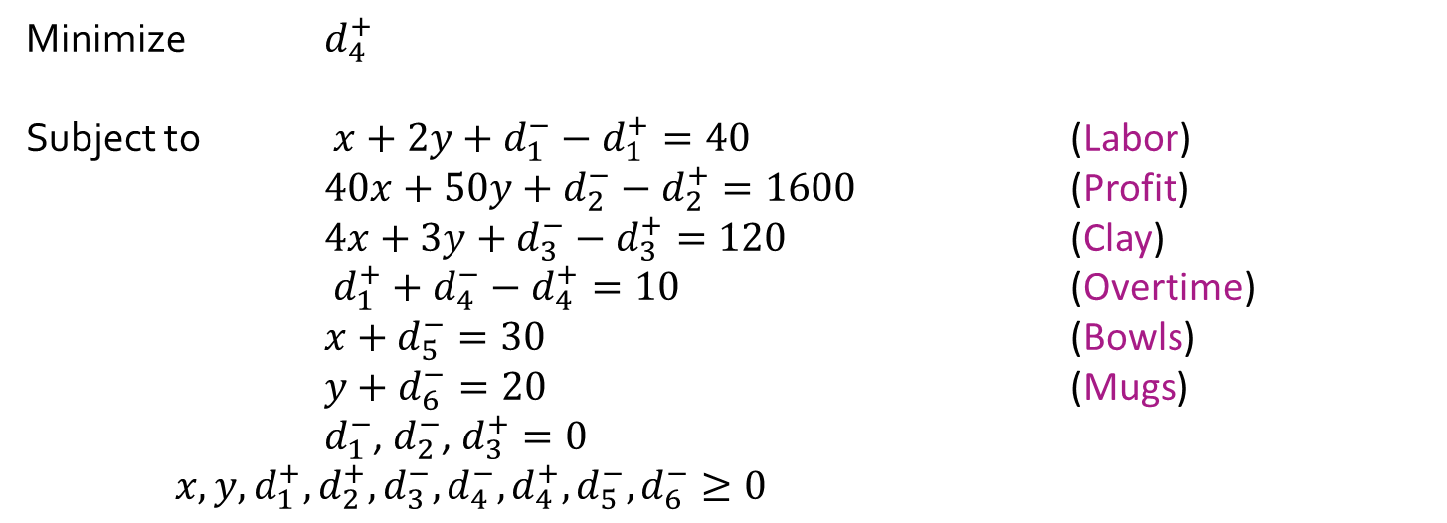
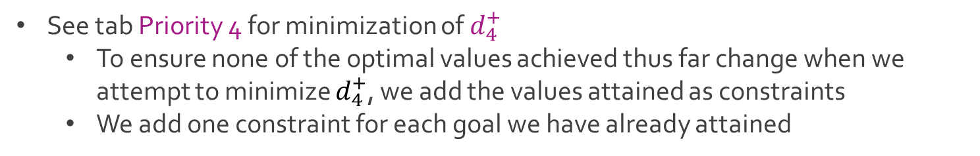
Ex: Beaver Creek Pottery
See tab Priority 4 for minimization of $d_{4}^{+}$
To ensure none of the optimal values achieved thus far change when we attempt to minimize $d_{4}^{+}$, we add the values attained as constraints
We add one constraint for each goal we have already attained
Minimize $d_{4}^{+}$
Subject to $x+2y+d_{1}^{−}−d_{1}^{+}=40$ (Labor)
$40x+50y+d_{2}^{−}−d_{2}^{+}=1600$ (Profit)
$4x+3y+d_{3}^{−}−d_{3}^{+}=120$ (Clay)
$d_{1}^{+}+d_{4}^{−}−d_{4}^{+}=10$ (Overtime)
$x+d_{5}^{−}=30$ (Bowls)
$y+d_{6}^{−}=20$ (Mugs)
$d_{1}^{−}$, $d_{2}^{−}$, $d_{3}^{+}=0$ $x,y,d_{1}^{+},d_{2}^{+},d_{3}^{−},d_{4}^{−},d_{4}^{+},d_{5}^{−},d_{6}^{−}≥0$

Slide 17
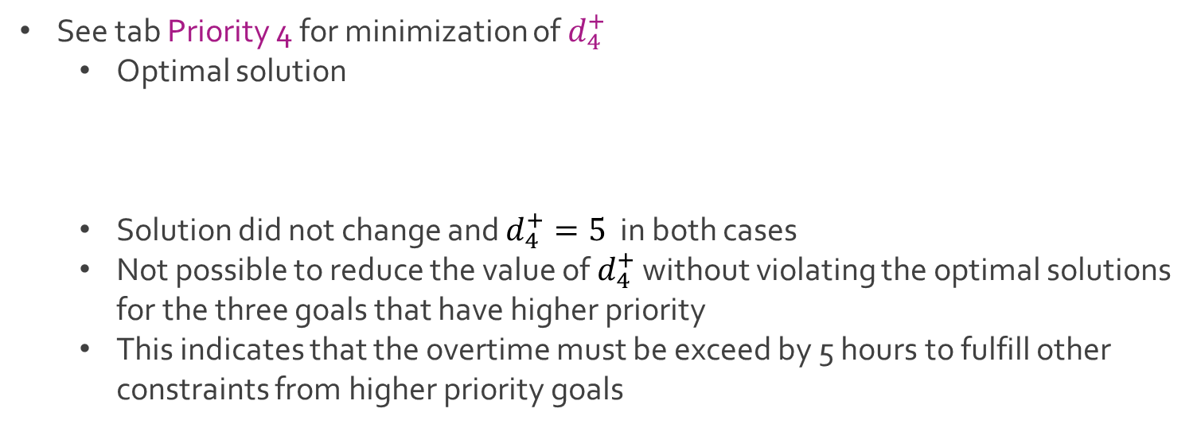
Ex: Beaver Creek Pottery
See tab Priority 4 for minimization of $d_{4}^{+}$
Optimal solution
Solution did not change and $d_{4}^{+}=5$ in both cases
Not possible to reduce the value of $d_{4}^{+}$ without violating the optimal solutions for the three goals that have higher priority
This indicates that the overtime must be exceed by 5 hours to fulfill other constraints from higher priority goals
$x=15 y=20 d_{1}^{+}=15 d_{4}^{+}=5 d_{5}^{−}=15$
$d_{1}^{−},d_{2}^{−},d_{2}^{+},d_{3}^{−},d_{3}^{+},d_{4}^{−},d_{6}^{−}=0$

Slide 18
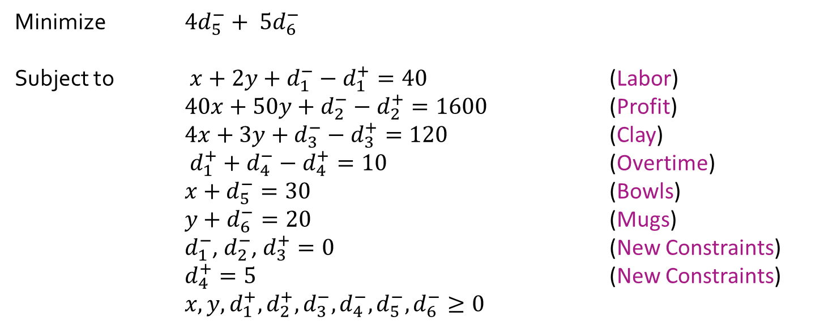
Ex: Beaver Creek Pottery
See tab Priority 5 for minimization of $4d_{5}^{−}+ 5d_{6}^{−}$
Add result from previous priority rank as a constraint
Minimize $4d_{5}^{−}+ 5d_{6}^{−}$
Subject to $x+2y+d_{1}^{−}−d_{1}^{+}=40$ (Labor)
$40x+50y+d_{2}^{−}−d_{2}^{+}=1600$ (Profit)
$4x+3y+d_{3}^{−}−d_{3}^{+}=120$ (Clay)
$d_{1}^{+}+d_{4}^{−}−d_{4}^{+}=10$ (Overtime)
$x+d_{5}^{−}=30$ (Bowls)
$y+d_{6}^{−}=20$ (Mugs)
$d_{1}^{−}$, $d_{2}^{−}$, $d_{3}^{+}=0$ (New Constraints)
$d_{4}^{+}=5$ (New Constraints) $x,y,d_{1}^{+},d_{2}^{+},d_{3}^{−}, d_{4}^{−},d_{5}^{−},d_{6}^{−}≥0$

Slide 19
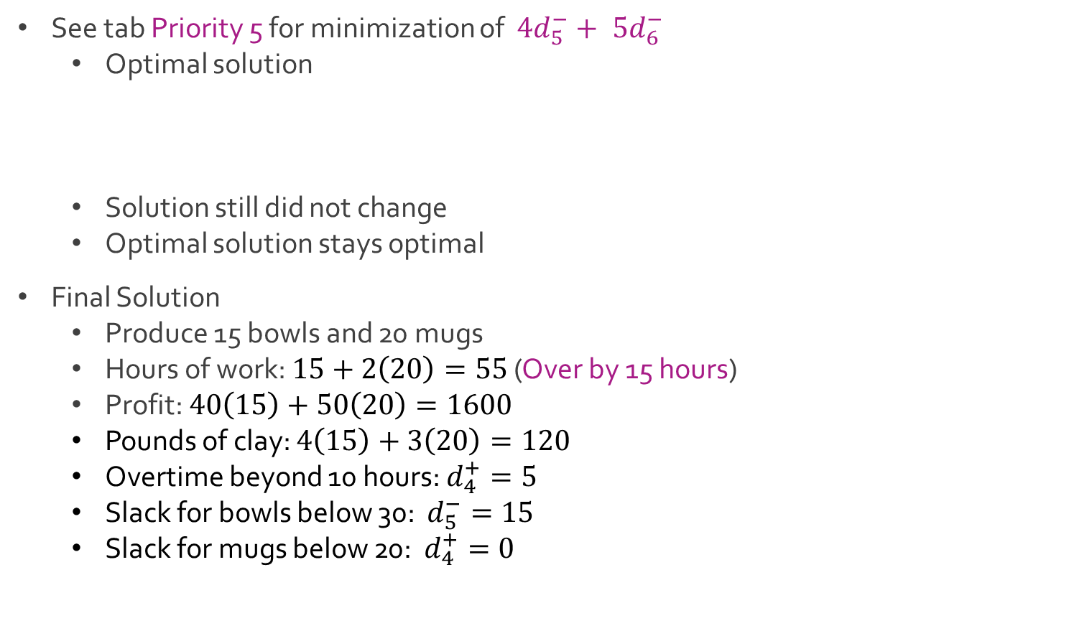
Ex: Beaver Creek Pottery
See tab Priority 5 for minimization of $4d_{5}^{−}+ 5d_{6}^{−}$
Optimal solution
Solution still did not change
Optimal solution stays optimal
Final Solution
Produce 15 bowls and 20 mugs
Hours of work: $15+2\left(20\right)=55$ (Over by 15 hours)
Profit: $40\left(15\right)+50\left(20\right)=1600$
Pounds of clay: $4\left(15\right)+3\left(20\right)=120$
Overtime beyond 10 hours: $d_{4}^{+}=5$
Slack for bowls below 30: $d_{5}^{−}=15$
Slack for mugs below 20: $d_{4}^{+}=0$
$x=15 y=20 d_{1}^{+}=15 d_{4}^{+}=5 d_{5}^{−}=15$
$d_{1}^{−},d_{2}^{−},d_{2}^{+},d_{3}^{−},d_{3}^{+},d_{4}^{−},d_{6}^{−}=0$

Slide 20
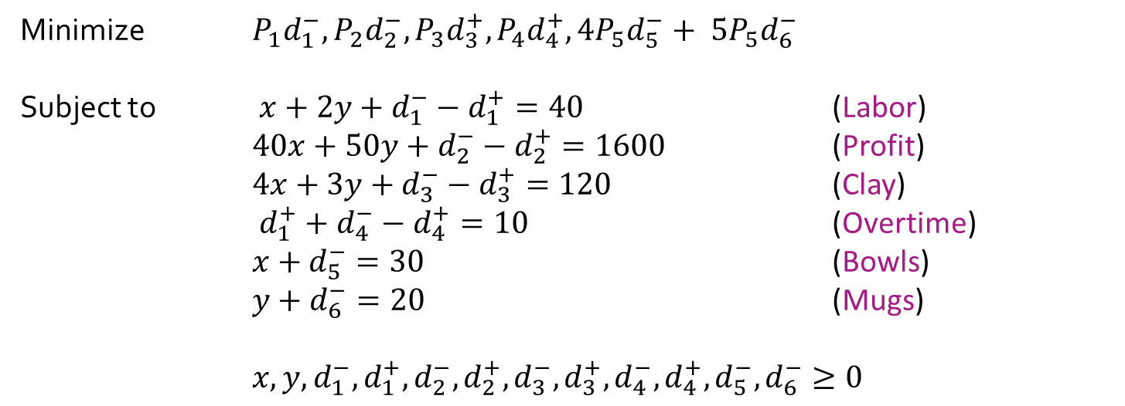
Ex: Beaver Creek Pottery
Full modified goal programming model
Minimize $P_{1}d_{1}^{−}, P_{2}d_{2}^{−}, P_{3}d_{3}^{+},P_{4}d_{4}^{+},{4P}_{5}d_{5}^{−}+ {5P}_{5}d_{6}^{−}$
Subject to $x+2y+d_{1}^{−}−d_{1}^{+}=40$ (Labor)
$40x+50y+d_{2}^{−}−d_{2}^{+}=1600$ (Profit)
$4x+3y+d_{3}^{−}−d_{3}^{+}=120$ (Clay)
$d_{1}^{+}+d_{4}^{−}−d_{4}^{+}=10$ (Overtime)
$x+d_{5}^{−}=30$ (Bowls)
$y+d_{6}^{−}=20$ (Mugs)
$x,y,d_{1}^{−},d_{1}^{+},d_{2}^{−},d_{2}^{+},d_{3}^{−},d_{3}^{+},d_{4}^{−},d_{4}^{+},d_{5}^{−},d_{6}^{−}≥0$

Slide 21




The End
Dale

